Slide 1
Modeling machine failure in the IoT era
Danielle Dean, PhD
Senior Data Scientist Lead
Microsoft

Slide 2
Outline
Predictive Maintenance Use Cases
Building E2E solution with Cortana Analytics Suite
Data
Modeling, Evaluation

Slide 3
Predictive Maintenance Concepts
Important task in Internet of Things applications
Goal: improve production/maintenance efficiency
 | Predictive Maintenance in IoT | Traditional Predicative Maintenance
Goal | Improve production and/or maintenance efficiency | Ensure the reliability of machine operation
Data | Data stream (time varying features), Multiple data sources | Very limited time varying features
Scope | Component level, System level | Parts level
Approach | Data driven | Model driven
Tasks | Failure prediction, fault/failure detection & diagnosis, maintenance actions recommendation, etc. Essentially any task that improves production/maintenance efficiency | Failure prediction (prognosis), fault/failure detection & diagnosis (diagnosis)

Slide 4

Predictive Maintenance Use Cases
Aerospace
Utilities
Manufacturing
Transportation & Logistics
What is the likelihood of delay due to mechanical issues?
When is my solar panel or wind turbine going to fail next?
Will the component pass the next stage of testing on factory floor or do I need to rework?
Should I replace the break disks in my car or can I wait for another month?
When is this aircraft component likely to fail next?
Which circuit breakers in my system are likely to fail in the next month?
What is the root cause of the test failure?
What maintenance task should I perform on my elevator?
Is the ATM going to dispense the next 5 notes without failing?

Slide 5







Cortana Analytics Suite Transform data into intelligent action
Information Management
Big Data Stores
Machine Learning and Analytics
Dashboards and Visualizations
Business apps
Power BI
Azure
Data Factory
Azure
Machine Learning
Personal Digital Assistant
Azure
Data Lake
Cortana
People
Custom apps
Azure
Data Catalog
Azure
HDInsight (Hadoop)
Perceptual Intelligence
Azure
SQL Data Warehouse
Face, vision
Speech, text
Azure
Event Hub
Azure
Stream Analytics
Business Scenarios
Sensors and devices
Recommendations,
customer churn,
forecasting, etc.
Automated Systems
DATA
INTELLIGENCE
ACTION

Slide 6
Today’s Talk
Information Management
Data Stores
Machine Learning and Analytics
Dashboards and Visualizations
Power BI
Azure
Data Factory
Azure
Machine Learning
Azure
SQL Database
People
Azure
Event Hub
Azure
Stream Analytics
Business Scenarios
Sensors and devices
Maintenance scheduling, parts ordering…
Automated Systems
DATA
INTELLIGENCE
ACTION

Slide 7
Aircraft Engine Demo

Slide 8
Scenario
This is Kyle.
Kyle manages a team that maintains aircrafts.
His job is to make sure that his 100 aircrafts are running properly & especially that the aircraft engines don’t need service.
Kyle wants to prevent delays due to mechanical issues so his customers will be happy.

Slide 9
Scenario
Sadly, engines occasionally show signs of problems & must be taken out of service for maintenance or replacement.
To eliminate this occurrence, Kyle must maintain operations & figure out the best way to utilize resources in order to minimize delays due to mechanical issues.

Slide 10
Questions & Solutions
Cortana Analytics to the Rescue!
1. How long did engines run in the past?
2. Which are showing signs of failure?
3. Which engines are likely to fail in the future?

Slide 11

Components
Training Data:
Aircraft engine run to failure data from NASA Ames Prognostics Data Repository
Azure
Blob Storage
2
Azure
Machine Learning Batch API
3
1 4
Azure
Data Factory
Aircraft engine real-time data based on NASA Ames Prognostics Data Repository
Azure
Event Hub
Azure
Stream Analytics
Azure
SQL Database
Real-time
Batch updates
Power BI

Slide 12
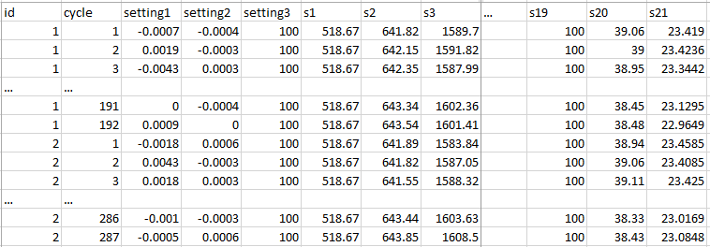
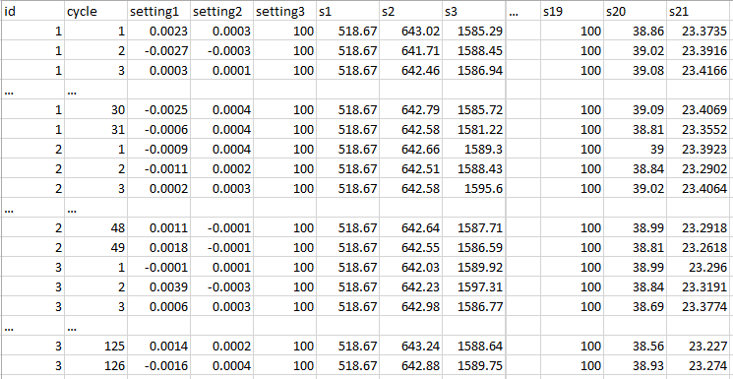

Sample training data
~20k rows,
100 unique engine id
Sample testing data
~13k rows,
100 unique engine id
Sample ground truth data
Please refer to following link of doc for Data description section
100 rows

Slide 13
Conclusion
With the visualization prowess of Power BI, business owners can easily examine the performance of their entire company.
Kyle is a happy man!
The Internet of Things and Stream Analytics connect data directly from the source to a dashboard to constantly track anomalies and asset performance in real-time.
Azure Machine Learning catches the problem before it becomes a problem. It streamlines operations without wasting resources.

Slide 14
Is the customer ready for ML?
The better the raw materials, the better the product.
Question is sharp.
Data measures what they care about.
Data is accurate.
Data is connected.
A lot of data.
E.g. Predict whether component X will fail in the next Y days
E.g. Identifiers at the level they are predicting
E.g. Failures are really failures, human labels on root causes
E.g. Machine information linkable to usage information
E.g. Will be difficult to predict failure accurately with few examples

Slide 15
Qualification Criteria
For ML-based solution:
Problem is predictive in nature
Clear path of action if potential failures detected
Data with sufficient quality
For predicting time left to failure, do you have failures or some proxy recorded?
Do you have enough failures to be able to model?
Is the “non-IoT” data in usable format?
Can the domain knowledge, such as timing of maintenance recordings, be translated into usable data for modeling?

Slide 16
Data Sources
FAILURE HISTORY
REPAIR HISTORY
MACHINE CONDITIONS
The failure history of a machine or component within the machine.
The repair history of a machine, e.g. previous maintenance records, components replaced, maintenance activities performed. Maintenance types.
The operation conditions of a machine, e.g. data collected from sensors.
MACHINE FEATURES
OPERATING CONDITIONS
OPERATOR ATTRIBUTES
The features of machine or components, e.g. production date, technical specifications.
Environmental features that may influence a machine’s performance, e.g. location, temperature, other interactions.
The attributes of the operator who uses the machine, e.g. driver.

Slide 17
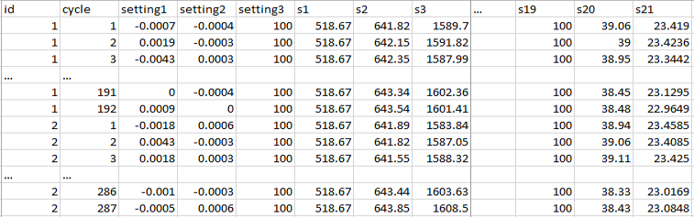
Feature Engineering
The process of creating features that provide better or additional predictive power to the learning algorithm.
a1 | a2 | … | a21 | sd1 | sd2 | … | sd21 | RUL | label1 | label2
40+ engineered features
Other potential features: change from initial value, velocity of change, frequency count over a predefined threshold

Slide 18
Example Feature Engineering Methods
1- Rolling aggregates:
For each labelled record of an asset, pick a rolling window of size w, compute rolling aggregate features for the periods before the labelling date and time of that record.
Create features that capture degradation over time.
2- Lag features for short term:
For each labelled record of an asset, pick a window of size w and use tumbling windows to create aggregate features for the periods before the labelling date and time.
3- Lag features for long term:
For each labelled record, find aggregated features for a larger window than w reflecting the long term effects.

Slide 19
Modelling Techniques
BINARY CLASSIFICATION
REGRESSION
Predict failures within a future period of time
Predict remaining useful life, the amount of time before the next failure
MULTICLASS CLASSIFICATION
ANOMALY DETECTION
Predict failures with their causes within a future time period.
Predict remaining useful life within ranges of future periods
Identify change in normal trends to find anomalies

Slide 20
Data Labeling
id | cycle | … | RUL | label1 | label2
1 | 1 |  | 191 | 0 | 0
1 | 2 |  | 190 | 0 | 0
1 | 3 |  | 189 | 0 | 0
1 | 4 |  | 188 | 0 | 0
… |  |  | … | … | …
1 | 160 |  | 32 | 0 | 0
1 | 161 |  | 31 | 0 | 0
1 | 162 |  | 30 | 1 | 1
1 | 163 |  | 29 | 1 | 1
1 | 164 |  | 28 | 1 | 1
1 | 165 |  | 27 | 1 | 1
1 | 166 |  | 26 | 1 | 1
1 | 167 |  | 25 | 1 | 1
1 | 168 |  | 24 | 1 | 1
1 | 169 |  | 23 | 1 | 1
1 | 170 |  | 22 | 1 | 1
1 | 171 |  | 21 | 1 | 1
1 | 172 |  | 20 | 1 | 1
1 | 173 |  | 19 | 1 | 1
1 | 174 |  | 18 | 1 | 1
1 | 175 |  | 17 | 1 | 1
1 | 176 |  | 16 | 1 | 1
1 | 177 |  | 15 | 1 | 2
1 | 178 |  | 14 | 1 | 2
1 | 179 |  | 13 | 1 | 2
1 | 180 |  | 12 | 1 | 2
1 | 181 |  | 11 | 1 | 2
1 | 182 |  | 10 | 1 | 2
1 | 183 |  | 9 | 1 | 2
1 | 184 |  | 8 | 1 | 2
1 | 185 |  | 7 | 1 | 2
1 | 186 |  | 6 | 1 | 2
1 | 187 |  | 5 | 1 | 2
1 | 188 |  | 4 | 1 | 2
1 | 189 |  | 3 | 1 | 2
1 | 190 |  | 2 | 1 | 2
1 | 191 |  | 1 | 1 | 2
1 | 192 |  | 0 | 1 | 2
Predefined window size for classification models
w1 = 30
w0 = 15
Regression
Binary classification
w1
Multi-class classification
w0

Slide 21
ML Process
Historical Data
[features + labels]
Future Data
[features only]
Define Objective
Split
Training Data
[features + labels]
Testing Data
[features + labels]
Access and Understand the data
Train Model
[model learns from training data]
Score Model
[model predicts on future data]
*
Score Model
[model predicts on testing data]
Pre-processing
Prediction Results
Evaluate Model
[Compare predicted results and true labels]
*Depending largely on size/complexity, may want to do pre-processing and/or feature/target construction before ingesting into AML Studio / AML API.

Slide 22
“Most IoT data are not used currently…
the data that are used today are mostly for anomaly detection and control, not optimization and prediction, which provide the greatest value.”¹
Notes:
Most IoT customer are looking for basic monitoring first (although they know there is value in ML). However, should think about ML and next steps because of importance of capturing data over long period of time! Most ML models need historical data to train.
-many customers we speak to need to re-do their data collection and come back at a later time after they start collecting the right data

Slide 23
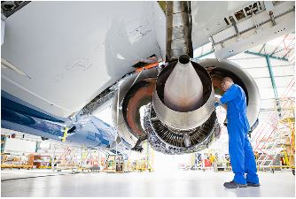
Go Dos
Learn from Cortana Analytics Gallery http://gallery.azureml.net (“predictive maintenance template” in collection)

Slide 24
Acknowledgements
We utilized the following publically available data to help us generate realistic data for this pre-configured solution. We received assistance in creating this solution as a result of this repository and the donators of the data.
“A. Saxena and K. Goebel (2008). "PHM08 Challenge Data Set", NASA Ames Prognostics Data Repository (http://ti.arc.nasa.gov/project/prognostic-data-repository), NASA Ames Research Center, Moffett Field, CA.”
Quote on Slide 23: McKinskey Global Institute, The Internet of Things: Mapping the Value beyond the hype

